Slide 1
Tuples, Lists and Dictionaries (and Sets)

Slide 2
Recap
Basic data types:
String
Numbers (Float, Integer)
Boolean (True, False)
Storing data types together:
tuple
list
set
dictionary
numpy array
pandas dataframe

Slide 3
This class...
We will discuss collection types:
tuple
list
set
dictionary
Then we will start working with:
numpy array
pandas dataframe

Slide 4
Definitions
Tuples - collection of objects that are ordered and immutable (cannot be modified).
Lists - ordered and mutable (changeable)
Sets - unordered and unindexed. Do not allow duplicate values to be held.
Dictionary - unordered collection that is indexed by a key which references a value.

Slide 5
Definitions
Tuples - collection of objects that are ordered and immutable (cannot be modified).
Lists - ordered and mutable (changeable)
Sets - unordered and unindexed. Do not allow duplicate values to be held.
Dictionary - unordered collection that is indexed by a key which references a value.

Slide 6
tuple
Tuple - A sequence of single data types (any type).
Tuples are very similar to list or string
length
a specific order
call (index) specific components.
immutable (similar to string)
x = (1, ‘two’, 3.0)
x = tuple(‘iftach’)
Note: only one input can be entered, and must be an iterator

Slide 7
tuple
Where do we encounter tuple ?
E.g., when we call a function that has multiple outputs (return values).
def my_function(x):
return(x+1, x+2, x+3)
returned_value = my_function(5)

Slide 8
list
Lists are very similar to tuple but they are mutable – you can access specific elements and change their value.
x = [1, ‘two’, 3.0]
x = list(‘iftach’)
x = ‘iftach amir’.split(‘ ‘)

Slide 9
Modifying list
mylist = [‘iftach’, ‘amir’, 1, 2, 3]
There are a number of ways modify lists:
indexing and changing values, e.g.
appending
x[0] = ‘amir’
x[2:5] = [4, 5, 6]
Notice that mylist is modified without being assigned an = operator.
mylist.append(1000)

Slide 10
Lists → methods
list.append(elem) -- adds a single element to the end of the list
list.insert(index, elem) -- inserts the element at the given index, shifting elements to the right
list.index(elem) -- searches for the given element from the start of the list and returns its index
list.remove(elem) -- searches for the first instance of the given element and removes it
list.reverse() -- reverses the list in place
list.extend(iterable) – extend the end of the list with all values of iterable
This is only a partial list of list methods

Slide 11

list with-in list
Lists can contain nested lists – or actually any variable such as tuples or dictionaries.
x = [[1, 2], [‘one’,‘two’]]
x[0]
x[0][1]

Slide 12

Open repl.it →
4.1 to 4.A,
7.1 to 7.D.

Slide 13
SETS
Open repl.it →
9.1 to 9.A

Slide 14
dictionary
list and tuple are a sequence array of data.
Dictionaries arrange data structure by keys rather than sequence order.
info = {
"name": "iftach",
"email": "iftach.amir@gmail.com",
"age": 35
}
print(info) print(info["email"])

Slide 15
dictionary
info = {
"name": "iftach",
"email": "iftach.amir@gmail.com",
"age": 35
}
print(info) print(info["email"])
KEY
VALUE
Notice: any variable can be a value

Slide 16
dictionary
Dictionaries can’t have duplicate keys.
You can add new data to dictionary by assigning value to a new key.
info["name"] = "amir"
info["department"] = "psychology"
print(info)

Slide 17
DICTIONARY
Open repl.it →
A.1 to A.8

Slide 18
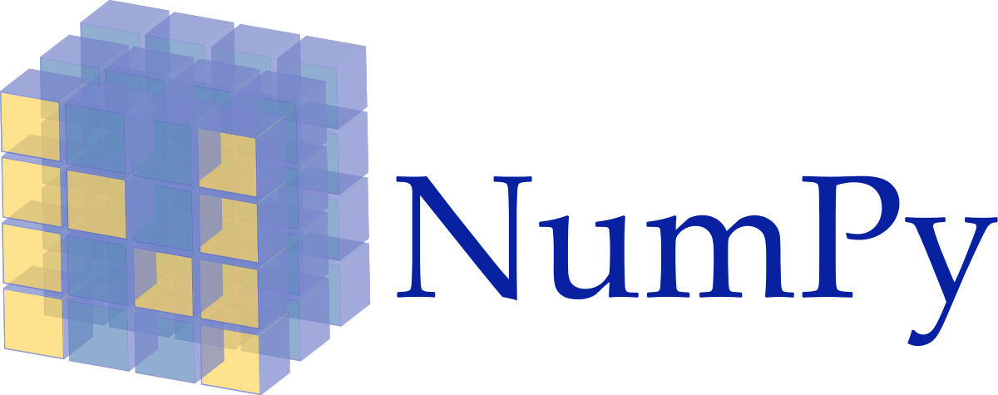
Numerical Python

Slide 19
import
import numpy as np
import command tells Python to import an installed package.
Most of the packages we will need come installed with Anaconda. To install additional packages see: link
the command as tells Python that we will call the numpy package as np – to shorten our code.

Slide 20
why numpy ?
“Python’s lists are efficient general-purpose containers. They support (fairly) efficient insertion, deletion, appending, and concatenation, and Python’s list comprehensions make them easy to construct and manipulate. However, they have certain limitations: they don’t support “vectorized” operations like elementwise addition and multiplication ...”
vector = [1, 5, 10, 1000]
vector = vector * 2

Slide 21
why numpy ?
vector = [1, 5, 10, 1000]
vector = vector * 2
Clearly, this code doesn’t do what we expected/wanted – which is to multiply each element by 2.
Practice → Write a Python code that does this.

Slide 22
why numpy ?
“NumPy is a Python extension module that provides efficient operation on arrays of homogeneous data. It allows Python to serve as a high-level language for manipulating numerical data”
import numpy as np
vector = np.array([1, 5, 10, 1000])
vector = vector * 2

Slide 23
why numpy ?
same principle applies to element-by-element operations with all operators (+ - * / etc.)
vector = np.array([1, 5, 10, 1000])
vector2 = np.array([2, 3, .5, 1])
print(vector * vector2)

Slide 24
why numpy ?
What will the following code do?
vector = np.array([1, 5, 10, 1000])
vector = vector + vector

Slide 25
why numpy ?
What about working with matrices (using simple list)?
matrix = [[1, 2, 3], [4, 5, 6]]
print(matrix)
matrix = [[1, 2, 3],
[4, 5, 6]]
print(matrix)

Slide 26
why numpy ?
How do we index the first element in the second row?
matrix = [[1, 2, 3], [4, 5, 6]]
print(matrix????)

Slide 27
numpy
An .array method can be 1-dimensional, 2-dimensional and so on (n-dimensional).
Use .shape to find out its shape.
vector1 = np.array([1, 5, 10, 1000])
vector1.shape
vector2 = np.array([[1, 2, 3, 4], [5, 6, 7, 8]])
vector2.shape

Slide 28
numpy
How do we index the first element in the second row in a numpy array?
vector2 = np.array([[1, 2, 3, 4], [5, 6, 7, 8]])
print(vector2)
print(vector2[???])

Slide 29
numpy
Arrays can be reshaped, for example:
.transpose()
.reshape(4, 2)
Note the difference in results between the two methods!
vector2 = np.array([[1, 2, 3, 4], [5, 6, 7, 8]])
vector2.transpose()
vector2 = np.array([[1, 2, 3, 4], [5, 6, 7, 8]])
vector2.reshape(4,2)

Slide 30
numpy
You can access specific “useful” locations, for e.g. :
matrix = np.array([[1, 2, 3], [4, 5, 6], [7, 8, 9]])
print(matrix.diagonal())
print(matrix.diagonal(1))

Slide 31
numpy
matrix = np.array([[1, 2, 3], [4, 5, 6], [7, 8, 9]])
Some useful methods:
.sum()
.mean()
.max()
.flatten()
try them out...

Slide 32
numpy
matrix = np.array([[1, 2, 3], [4, 5, 6], [7, 8, 9]])
Some useful methods:
.sum()
.mean()
.max()
.flatten()
try them out...

Slide 33
numpy
note the @ operator which does a matrix multiplication
matrix = np.array([[1,1,1], [1,1,1], [1,1,1]])
print(matrix @ matrix)

Slide 34
numpy
Creating an array
v = np.array([1, 2, 3, 4, 5, 6, 7, 8])
print(v)
v = np.arange(1, 9)
print(v)
v = np.arange(2, 101, 2)
print(v)

Slide 35
numpy
Creating an array
m = np.zeros([3, 3])
print(m)
m = np.ones([4, 5])
print(m)

Slide 36
numpy
Indexing a 2-dimensional array
m = np.arange(1,13).reshape([3,4])
print(m[2,3])
Row number(s)
Column number(s)

Slide 37
numpy
Indexing a 2-dimensional array
m = np.arange(1,13).reshape([3,4])
print(m[2,3])
print(m[0,0:])
print(m[0:,0])
m[0:,1] = 0
print(m[0:,1])
Index first row
Index first column
Index second column and replace values with 0 (broadcasting)

Slide 38
numpy – logical indexing
Getting index by conditional statement
m = np.arange(1,13).reshape([3,4])
idx = m % 2 == 0
print(idx)
print(m[idx])

Slide 39

full resource list https://docs.scipy.org/doc/numpy/reference/routines.html

